Slide 1

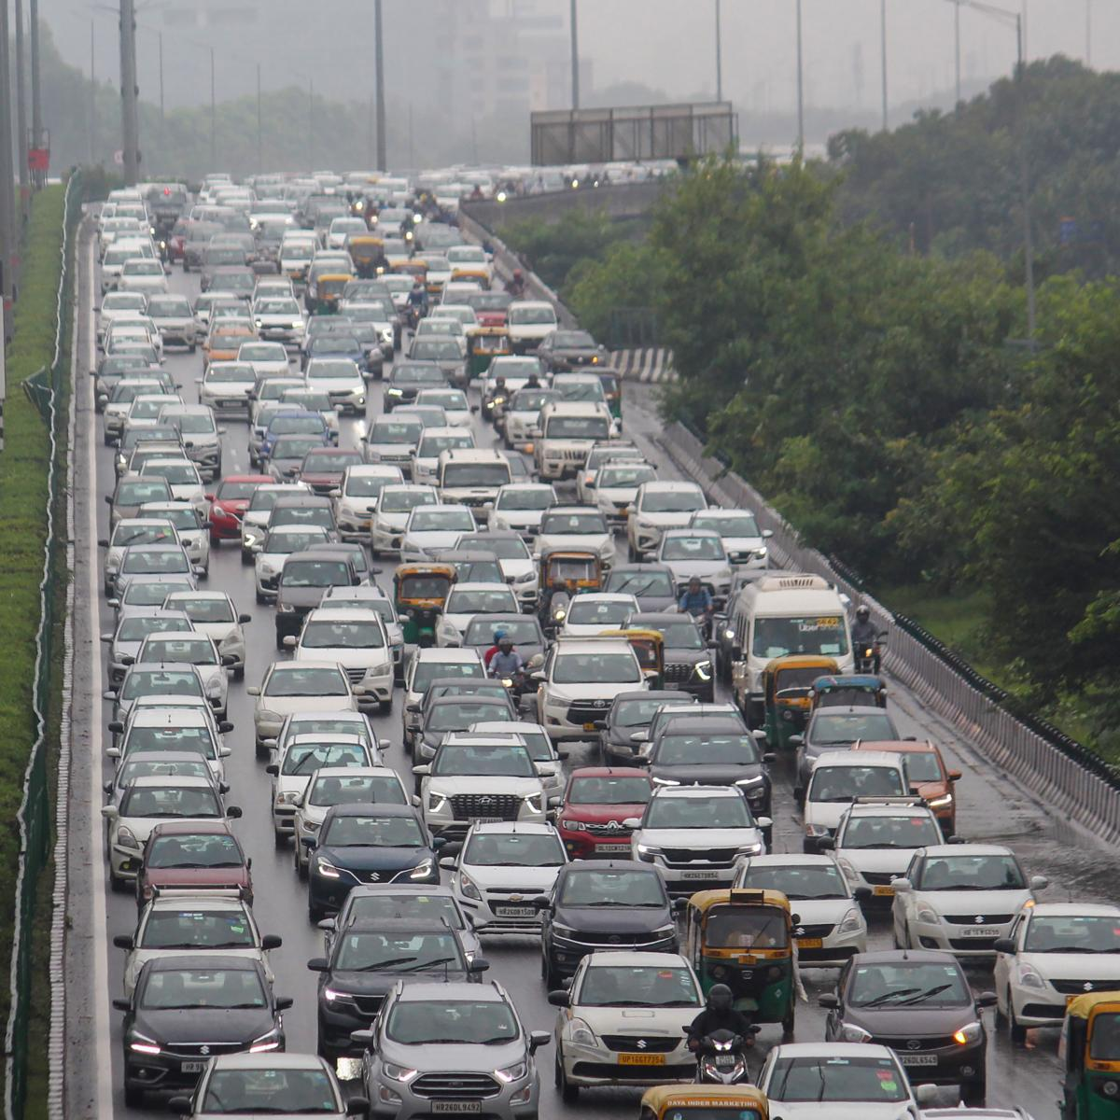
CVR COLLEGE OF ENGINEERING DEPARTMENT OF COMPUTER SCIENCE AND ENGINEERING
REAL TIME VIDEO BASED VEHICLE DETECTION, COUNTING AND CLASSIFICATION SYSTEM
BY
K SAI KEERTHAN – 19B81A05G3
R VISHAL – 19B81A05H7
T TANAY – 19RA1A0545
Under guidance of
M VASAVI (Assistant Professor)

Slide 2
Contents
Abstract
Introduction
Overview
Literature review – Literature Survey
Existing models
Proposed System
Software requirement/Technology stack
Hardware requirements
System Archietecture
UML diagrams
Implementation
Major functions of the code
13. Advantages
14. Conclusion

Slide 3
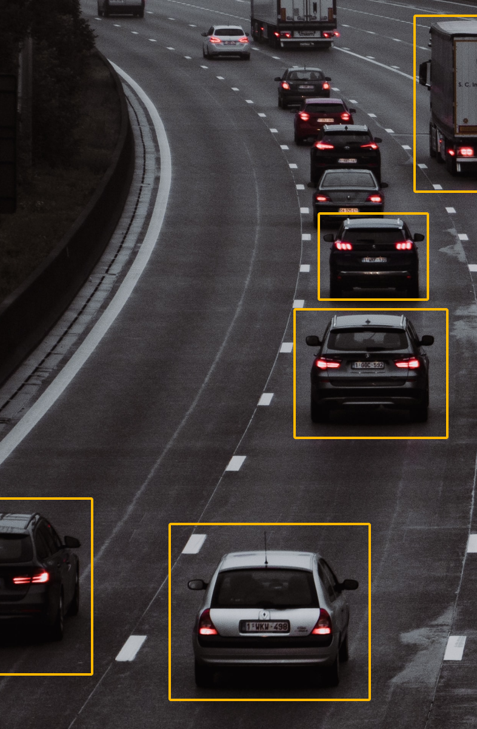
ABSTRACT
Traffic Analysis has been a problem that city planners have dealt with for years. Smarter ways are being developed to analyze traffic and streamline the process. Analysis of traffic may account for the number of vehicles in an area per some arbitrary time period and the class of vehicles. People have designed such mechanism for decades now but most of them involve use of sensors to detect the vehicles i.e., a couple of proximity sensors to calculate the direction of the moving vehicle and to keep the vehicle count. Even though over the time these systems have matured and are highly effective, they are not very budget friendly. The problem is such systems require maintenance and periodic calibration. Therefore, this project has purposed a vision-based vehicle counting and classification system. The system involves capturing of frames from the video to perform background subtraction in order detect and count the vehicles using Gaussian Mixture Model (GMM) background subtraction then it classifies the vehicles by comparing the contour areas to the assumed values. The substantial contribution of the work is the comparison of two classification methods. Classification has been implemented using Contour Comparison (CC) as well as Bag of Features (BoF) method.

Slide 4
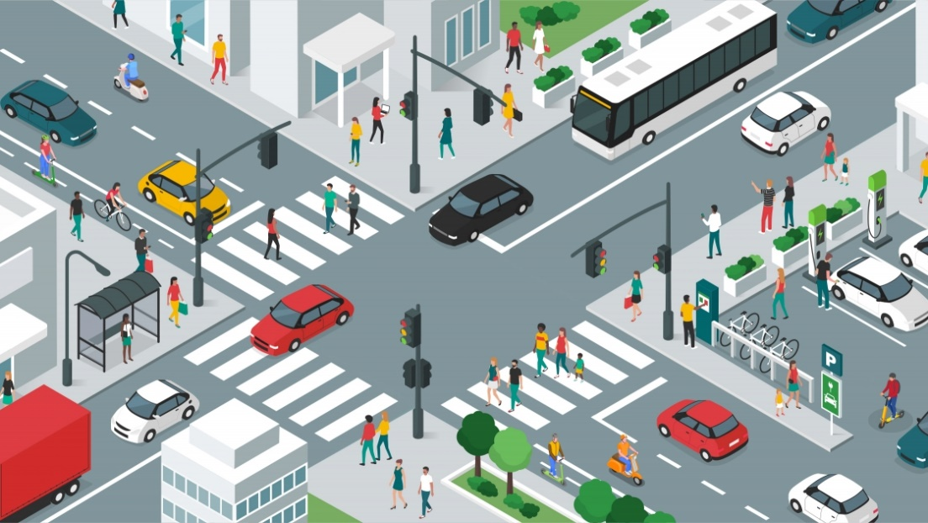
INTRODUCTION
The need of efficient management and monitoring of road traffic has increased in last few decades because of the increase in the road networks and the number of vehicles.
There are some regular traffic management techniques such as wireless sensor networks, Inductive loops and EM microwave detectors but these systems are expensive, bulky and are difficult to install.
A good alternative to these techniques can be video based surveillance systems. It is cheaper and better because of the increase in the storage capabilities, computational power and video encryption algorithms.
The videos stored by these surveillance systems are generally analyzed by humans, which is a time-consuming Job. To overcome this constraint, we need of more robust, automatic video-based surveillance systems.
This computer vision based uses virtual detection and capable of counting and classifying the vehicles in real time.

Slide 5
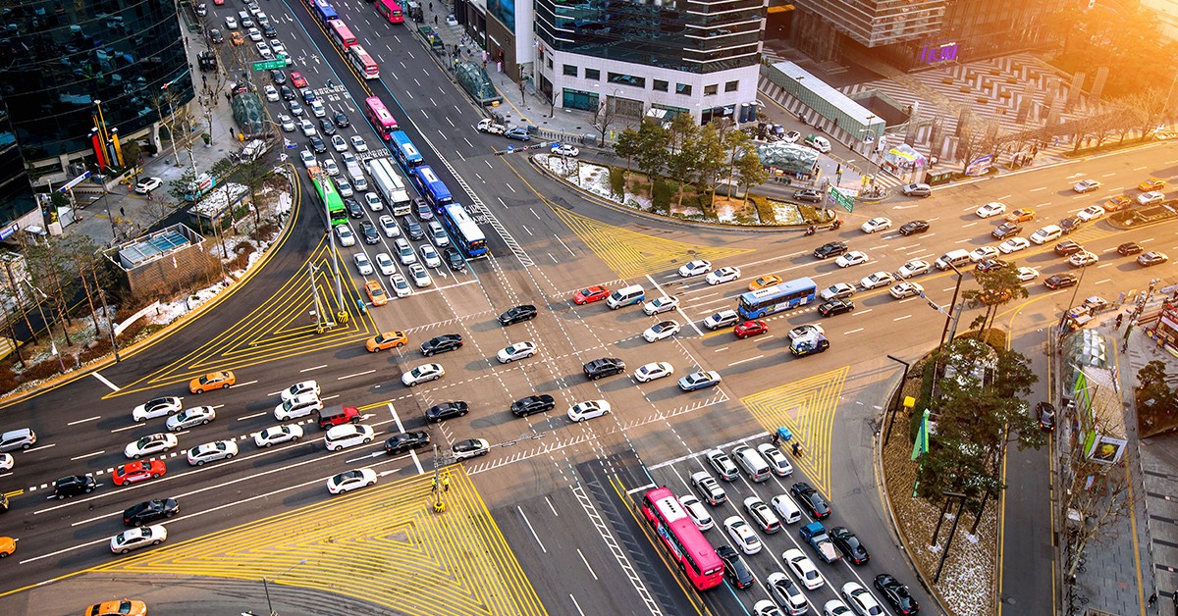
OVERVIEW
The main objectives of this project is to detect, track and classify the vehicles in real-time.
This project usually contains two parts, hardware and software.
This system is portable with a microcontroller attached to the camera for the real-time processing and analyses or just the cameras that transmit the video feed to a centralized computer for further processing.
Computer vision technology is used for traffic monitoring in this project.
This system can automatically identify and count moving objects as vehicle in real-time or from recorded videos, using background subtraction, image filtering, image binary and segmentation method.

Slide 6

LITERATURE SURVEY
In 2005, Hasegawa and Kanade introduced a system for detecting and classifying the moving objects by its type and color.
In 2013, Nilesh et al. designed and developed a system using python with OpenCV for detecting and counting moving vehicles.
In 2014, Da Li et al. developed real-time moving vehicle detection, tracking, and counting system also using python with OpenCV including adaptive subtracted background method in combination with virtual detector and blob tracking technology

Slide 7
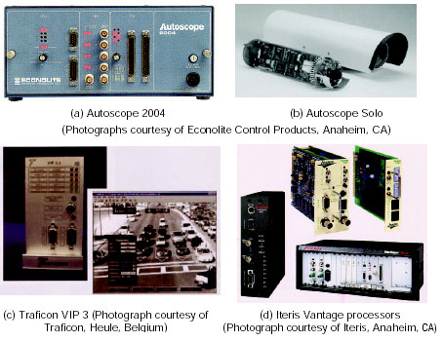
EXSISTING SYSTEMS
Autoscope Econolite
Citilog
Vantage iteris
Traficon

Slide 8
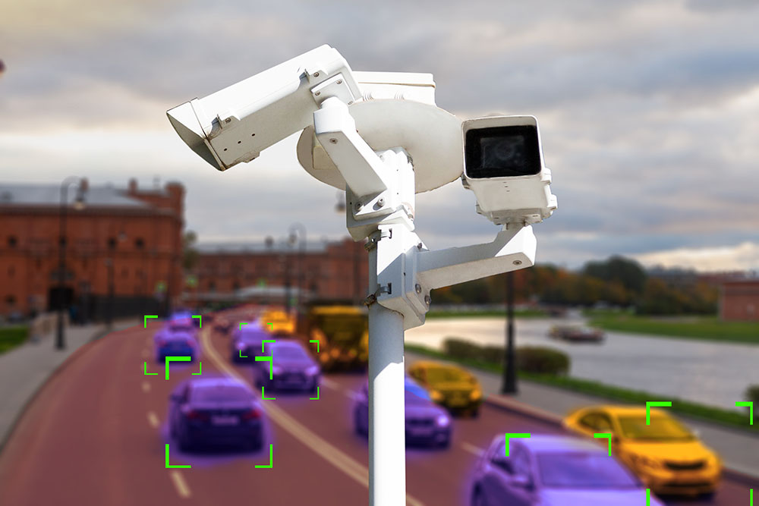
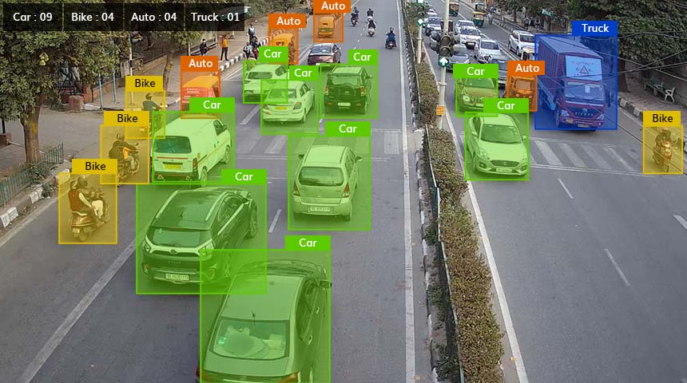
PROPOSED SYSTEM
We have proposed a real time video-based vehicle detection, classification, counting for real-time traffic data collection. The proposed system was built using python programming language and OpenCV.
This system is used for detection, recognition and tracking of the vehicles in the video frames and then classify the detected vehicles according to their size in three different classes.
The proposed system is based on three modules which are background learning, foreground extraction and vehicle classification.

Slide 9


SYSTEM DESIGN REQUIREMENTS
Operating System
Front-End
Coding Language
Windows 7 or Above
Flask
Python
Python

Slide 10
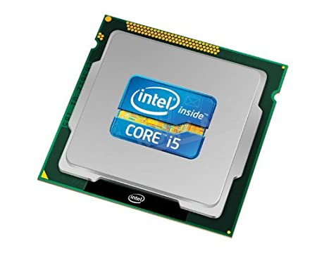
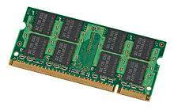
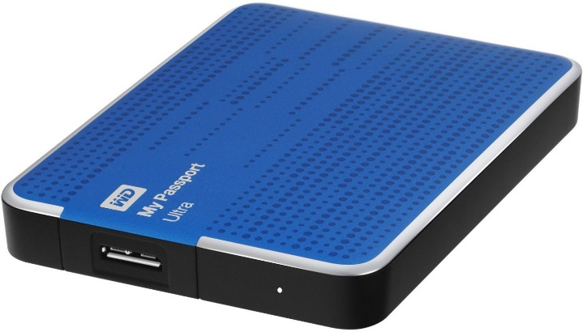
HARDWARE REQUIREMENTS
Hard Drive
Processor
RAM
256 GB
Intel i5 Processor
4 GB

Slide 11
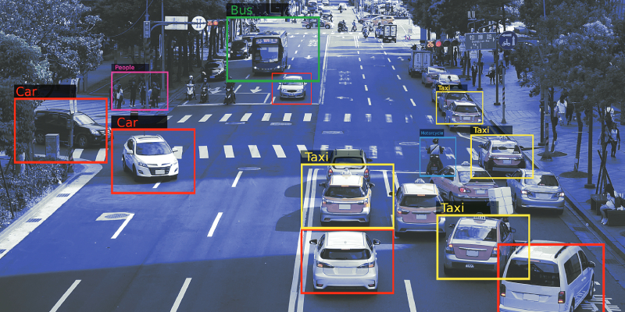
SYSTEM ARCHITECTURE
Camera or Video Data
New Frame
Background Learning
Background Subtraction
Image Enhancement
Foreground mask
Get the Vehicle outline
Feature Extraction
Vehicle Classification

Slide 12
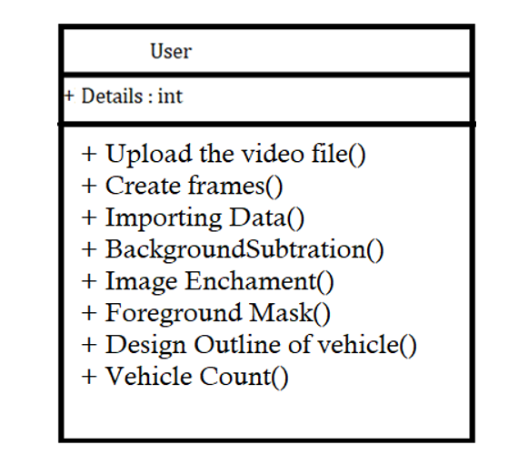
Class Diagram

Slide 13
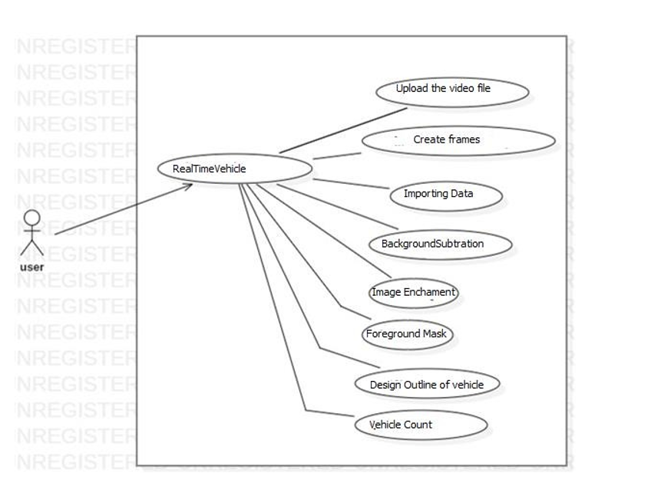
Use case Diagram

Slide 14
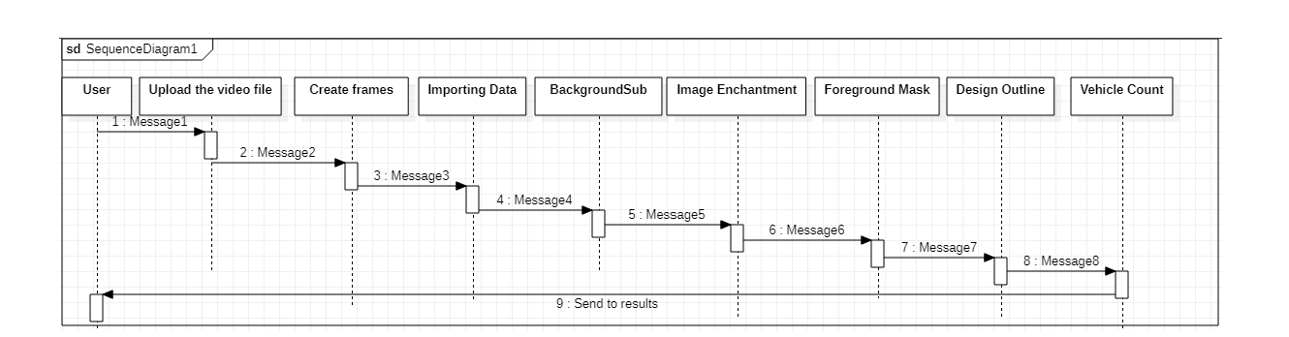
Sequence Diagram

Slide 15
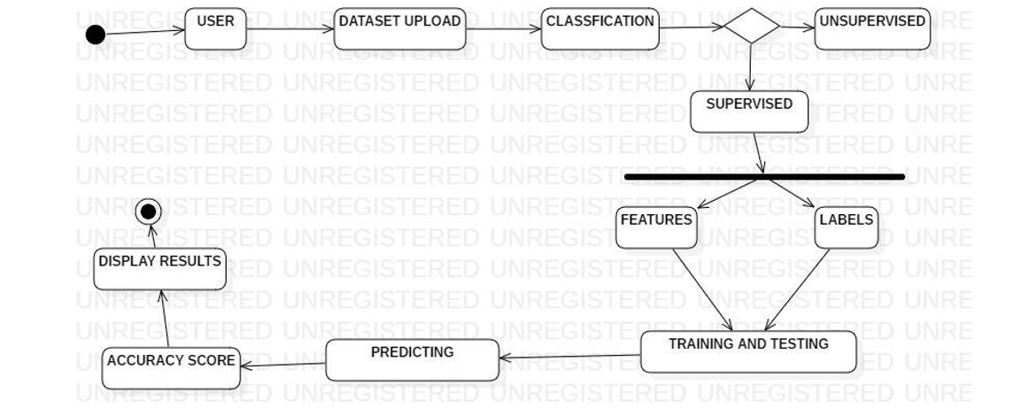
Activity Diagram

Slide 16

IMPLEMENTATION
Acquire Dataset
Obtaining Frames
Gaussian blur
Background Subtraction
Thresholding
Dilation
Foreground Mask
Design Outline
Vehicle Counting

Slide 17
MAJOR FUNCTIONS IN THE CODE
boxAndLineOverlap( ) - This function takes the midpoint coordinates of a bounding box and the coordinates of a line as input and checks if the box overlaps with the line.
displayFPS( ) - This function takes the start time and number of frames as input and displays the current frames per second (FPS) on the terminal.
drawDetectionBoxes( ) - This function takes the indices, bounding boxes, class IDs, confidences, and the current frame as input and draws bounding boxes and labels on the frame for each detected object.
count_vehicles( ) - This function takes the indices, bounding boxes, class IDs, vehicle count, detections from previous frames, and the current frame as input and counts the number of vehicles in the current frame. It also tracks the vehicles across frames and assigns a unique ID to each vehicle.

Slide 18
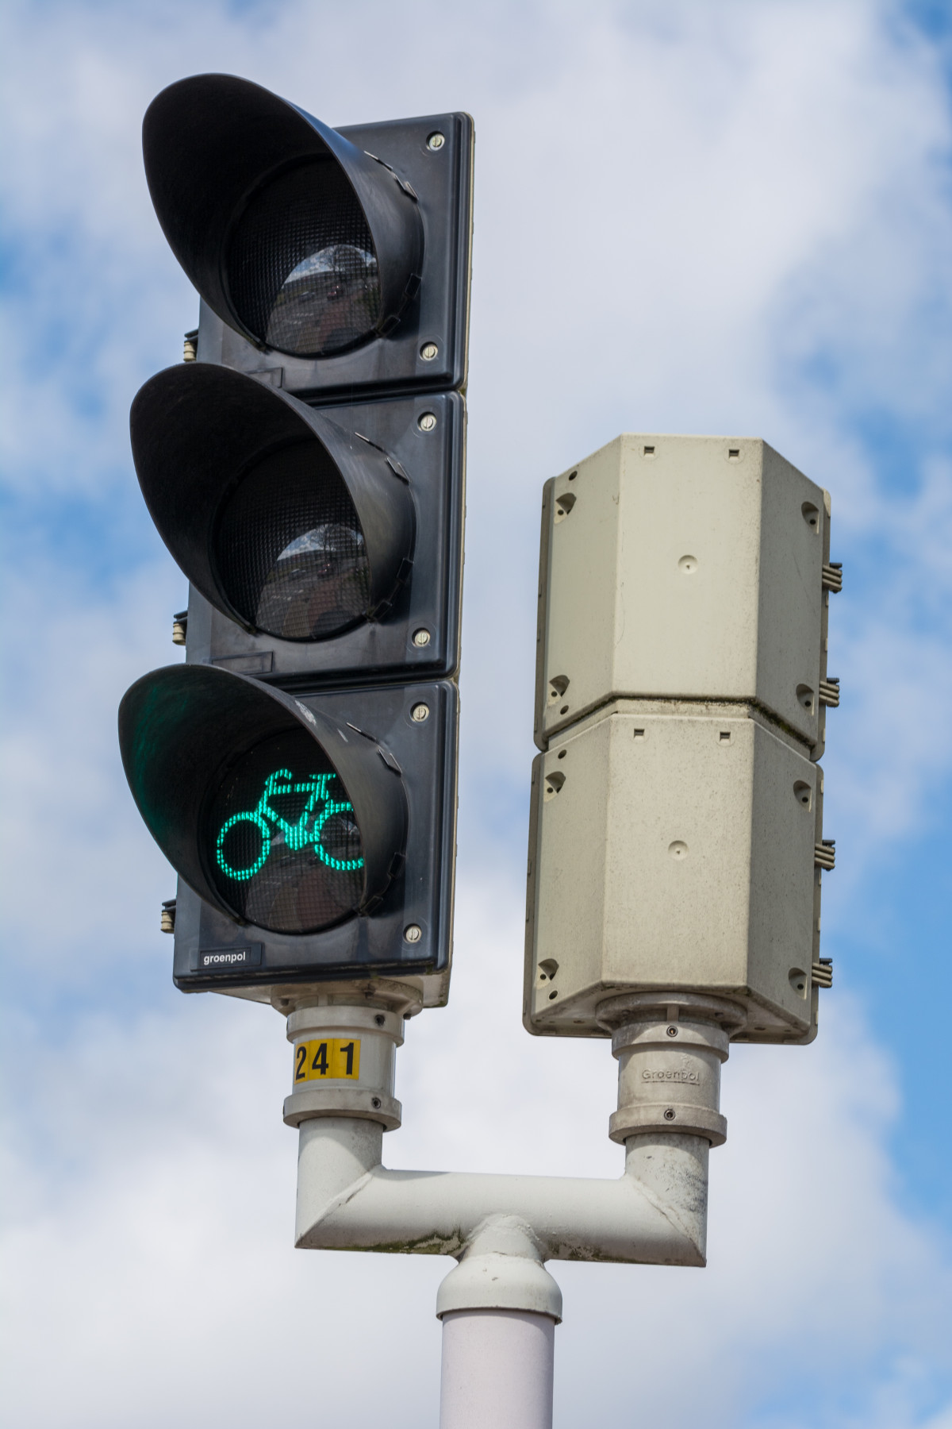
ADVANTAGES
No traffic disruption for installation.
Easy maintenance.
Covers wide area with single camera.
Provides rich visual information for manual inspection.

Slide 19
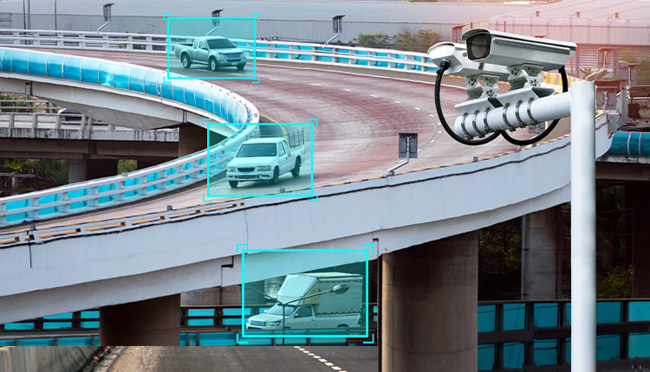
CONCLUSION
The vehicle traffic data from this application can be used to count and classify vehicles on busy roads. Once this application is used to gather the data of vehicle types. Open-Source Computer Vision Library (OpenCV) and Python Programming language is used to implement the method developed. The system in this is to calculate the number of vehicles passing on road. It was based on the detection of that cross the virtual line.

Slide 20
THANK YOU

